Slide 1
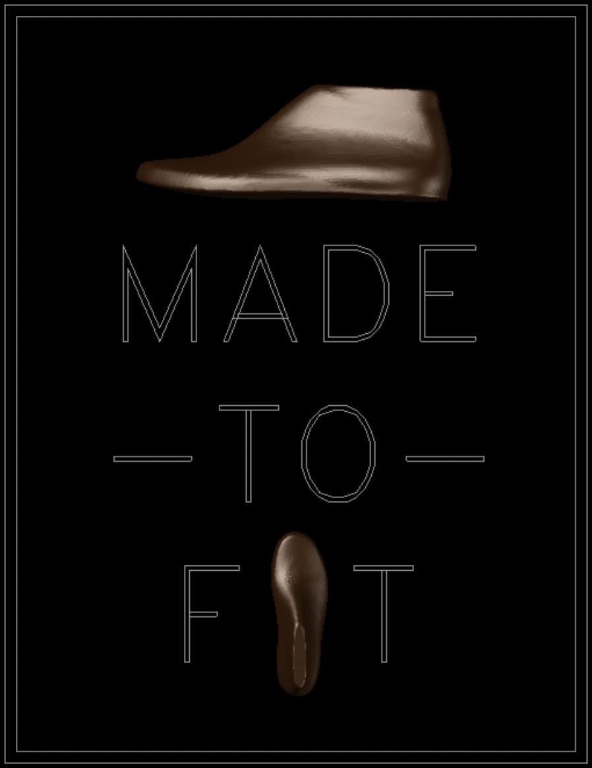
Made To Fit

Slide 2
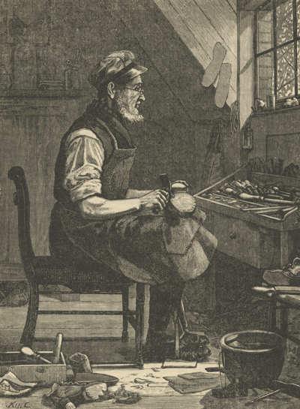
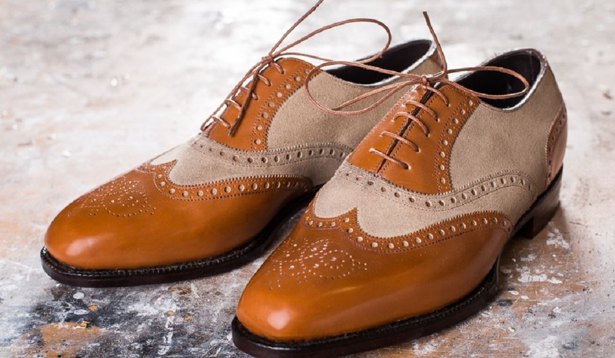
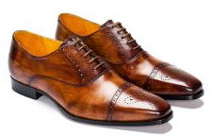
Shoe Making
One of the oldest crafts still practiced today
Origins date back to the 15th century
Mass production started in 1900's but tradition methods are still very popular

Slide 3
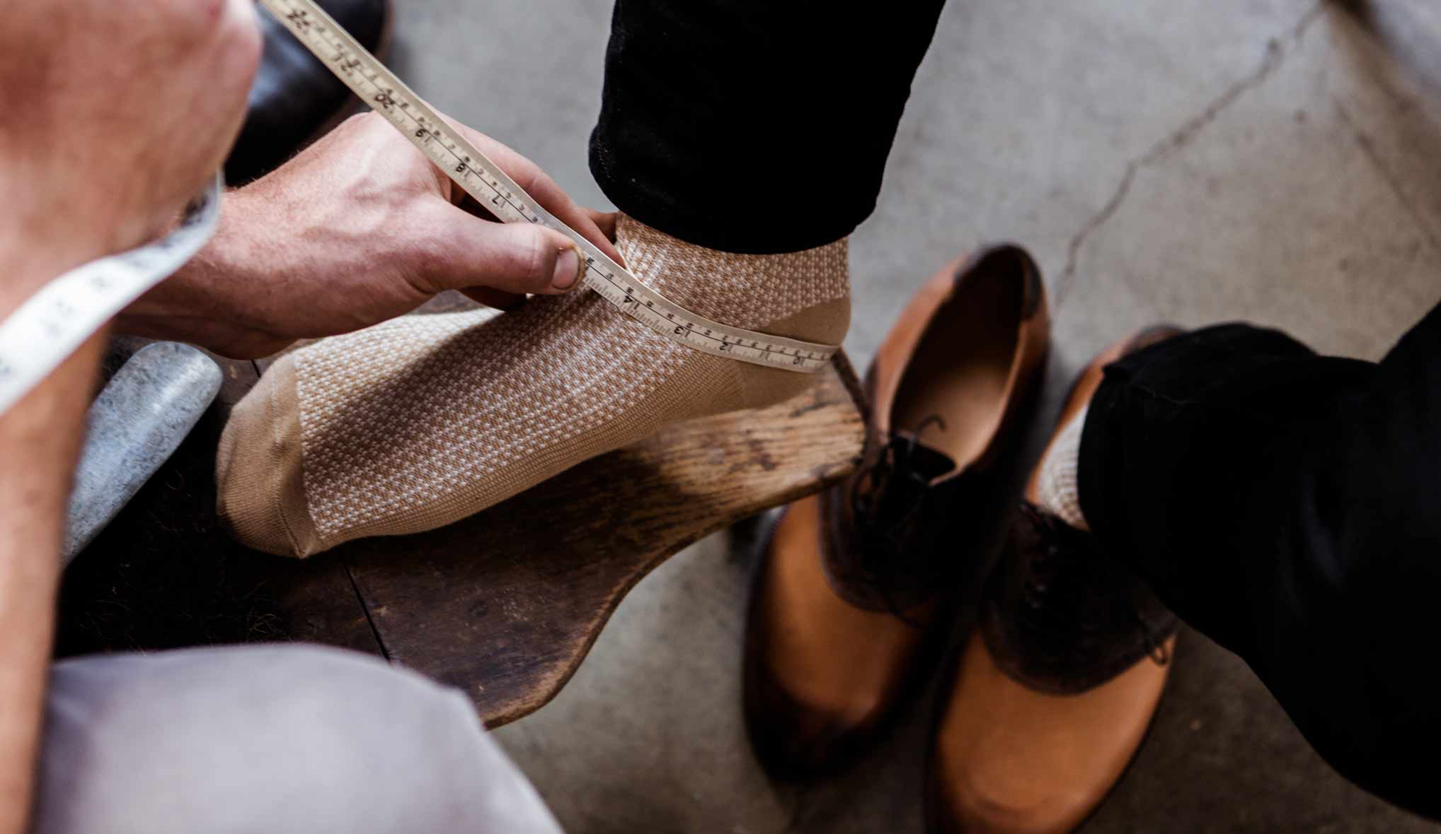
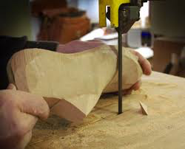
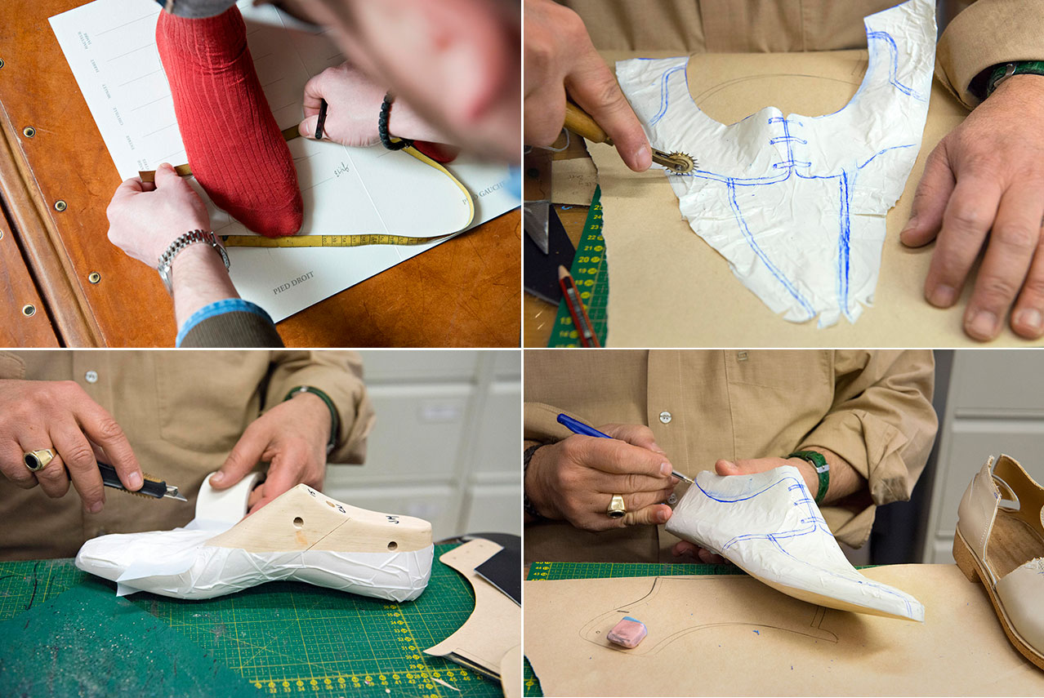
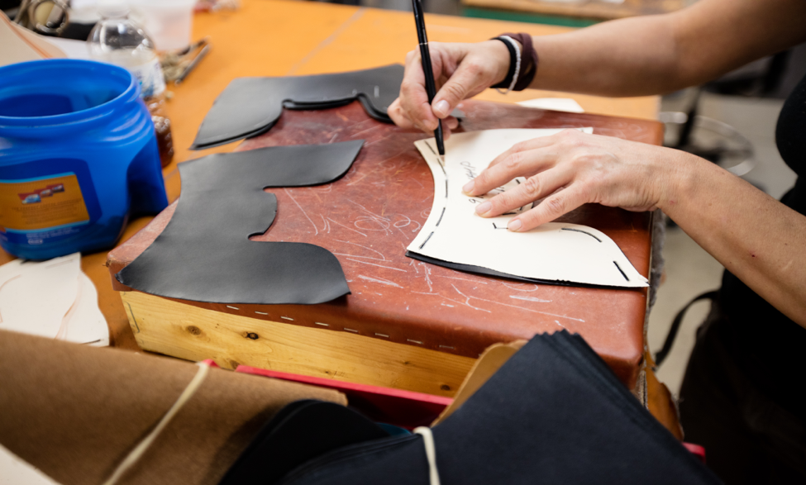
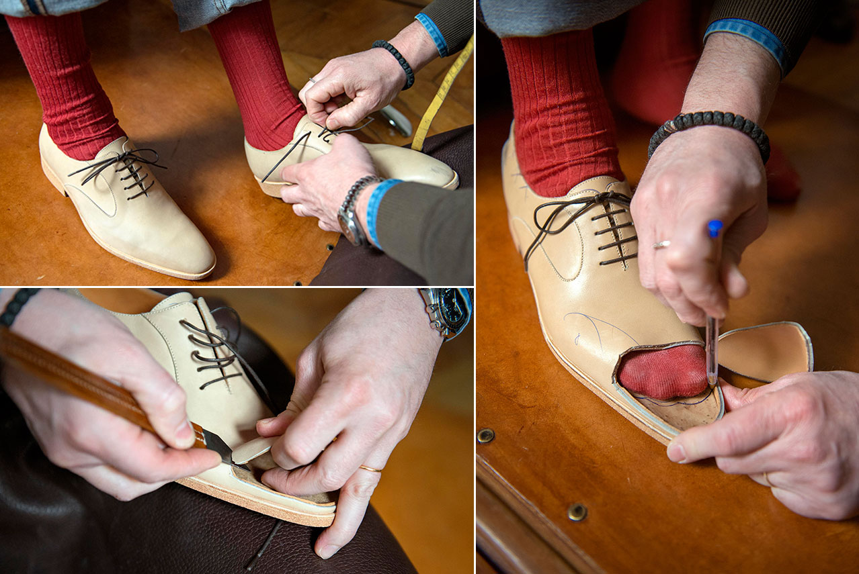
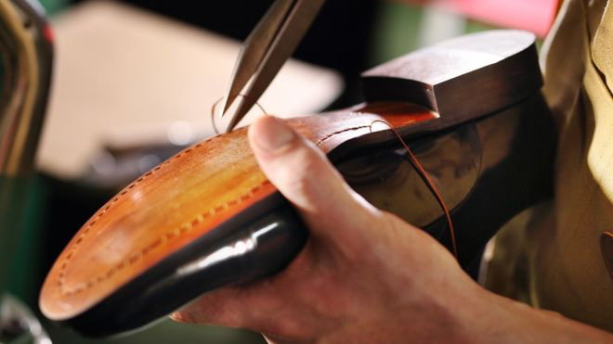
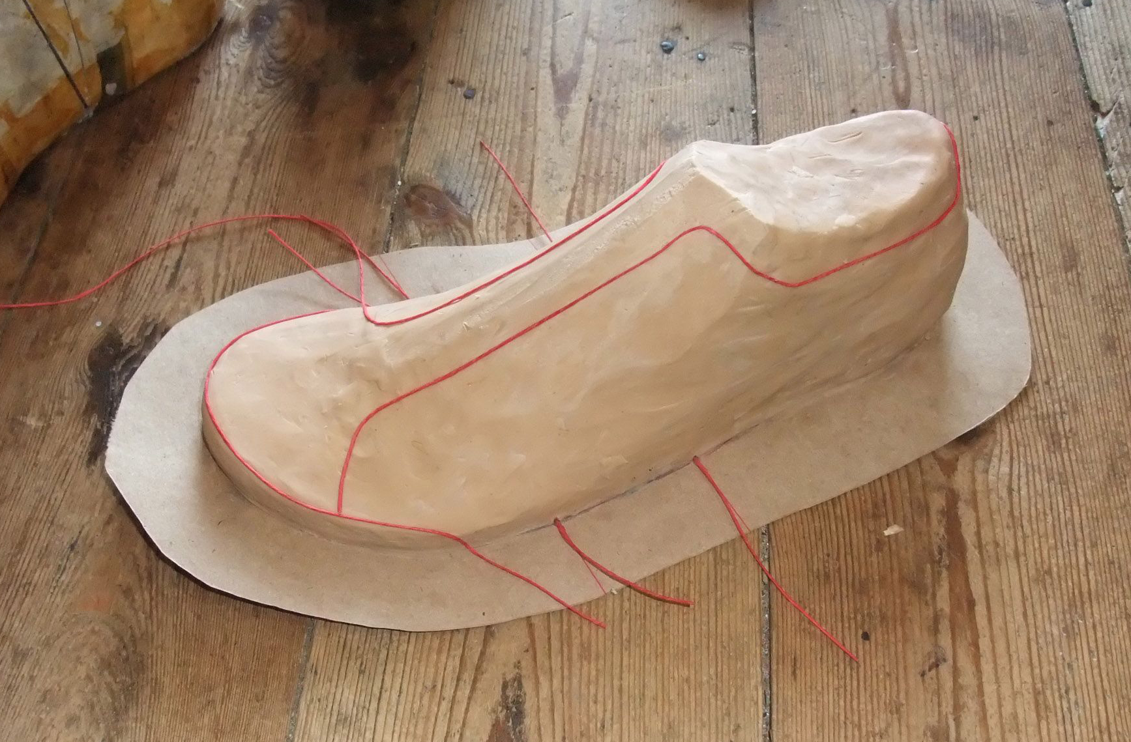
Shoe Making – The Process
Shoe maker takes measurements of the feet
Makes a last
Traces and cuts paper to get the shape of the last
Cuts the leather based on the paper tracing
Makes the custom pair of shoe
Fixes the shoe last
Makes a prototype pair of shoes

Slide 4
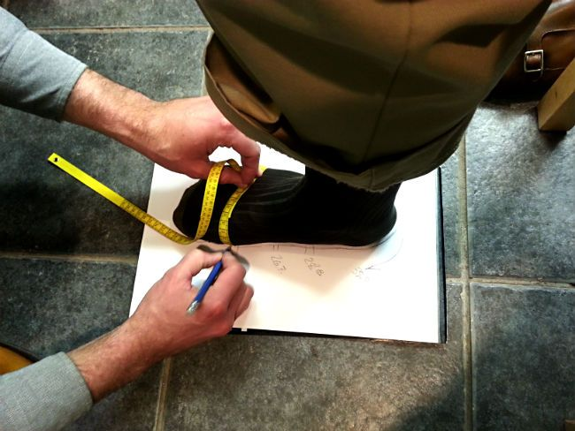
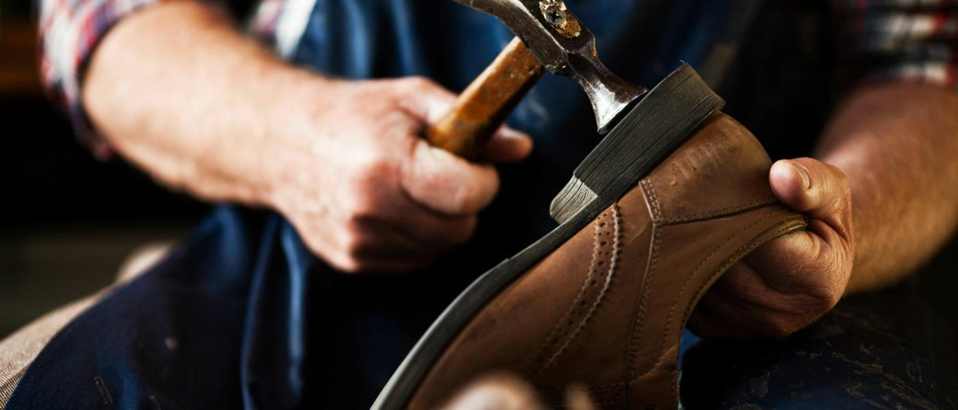
The Problem
Traditional shoemaker business is place bound
Process of taking measurements and manufacturing
Client care – may mean a lot of travelling
Difficult to expand
"Saving instead spending" money and time
Last production
travelling

Slide 5


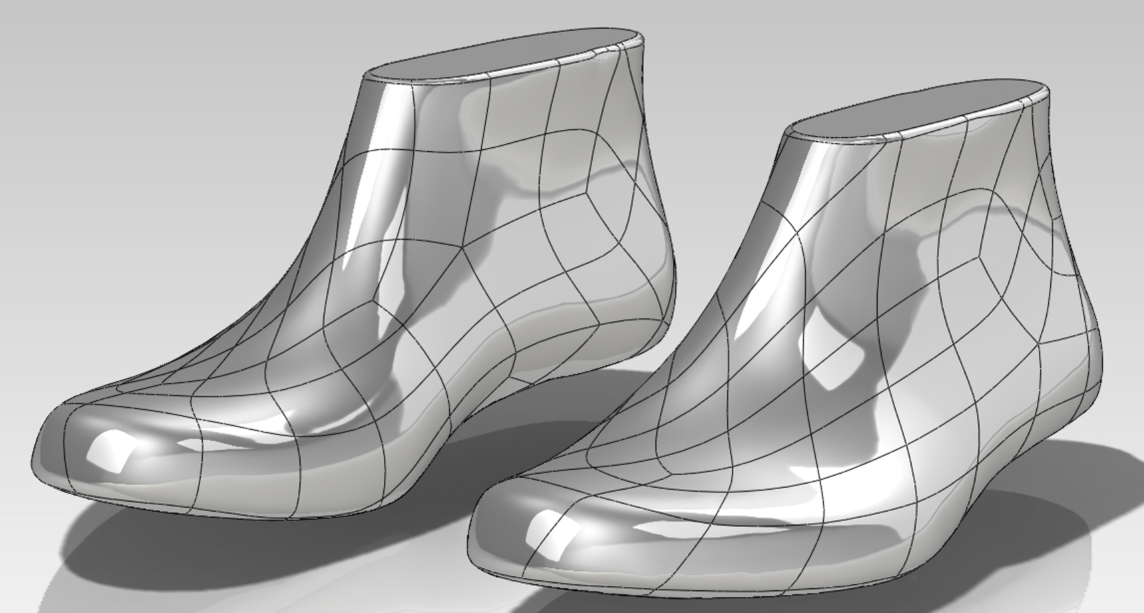
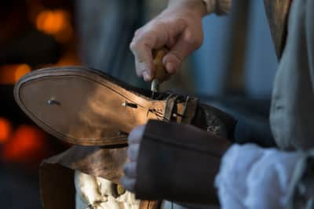

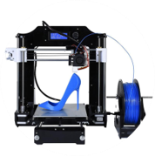
Our Solution
Unique Shoe Last
Algorithm
Video of foot
Custom pair of shoes
Delivery to Shoe Maker
3D Printing

Slide 6
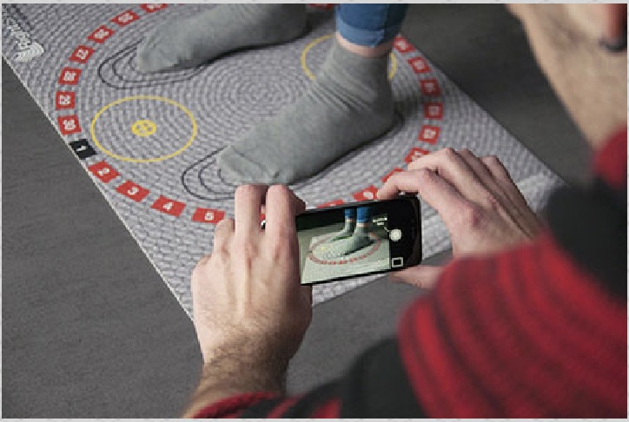
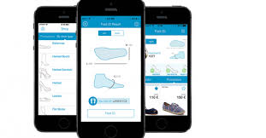


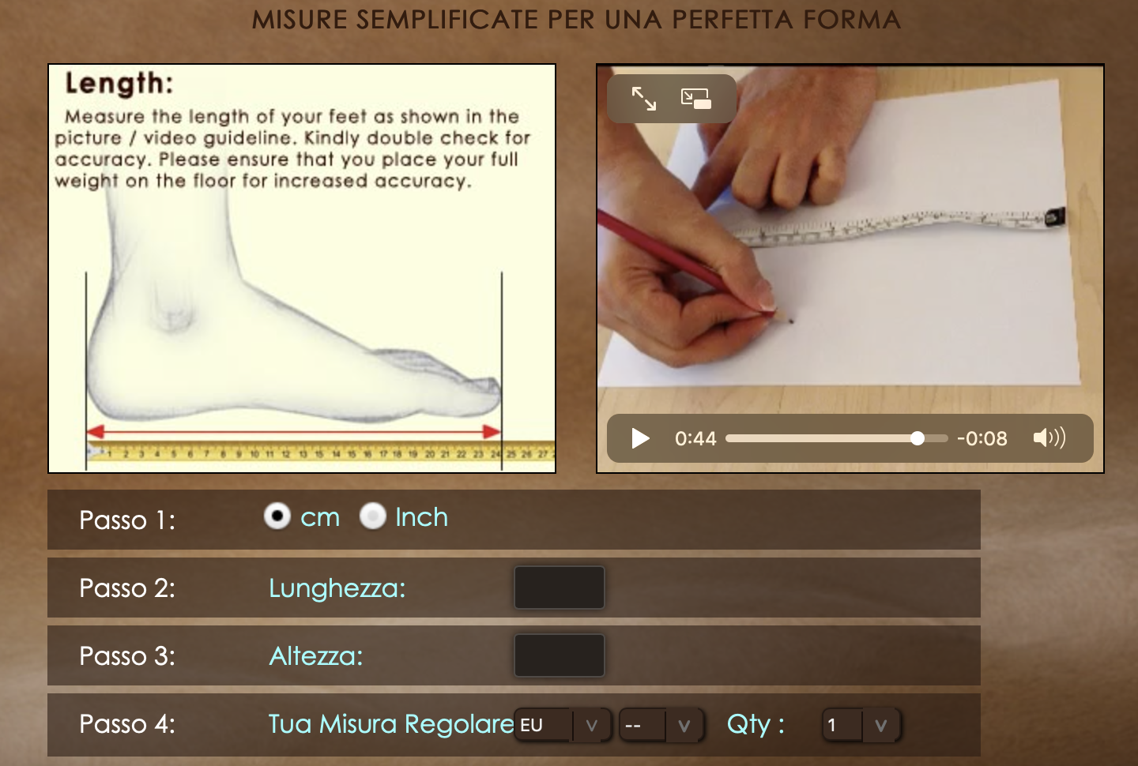
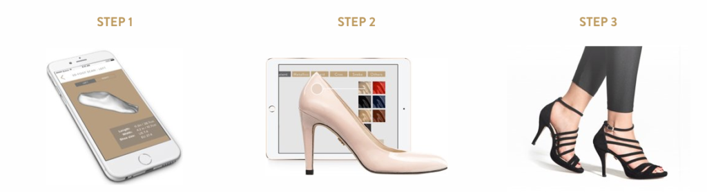


Competitors
No one else is offering this service that has partnered with shoe makers
RightShoes
Need extra materials to use
Feetit
Inaccurate
itailorshoes
User must measure feet
True Gault
Only for women's shoes

Slide 7
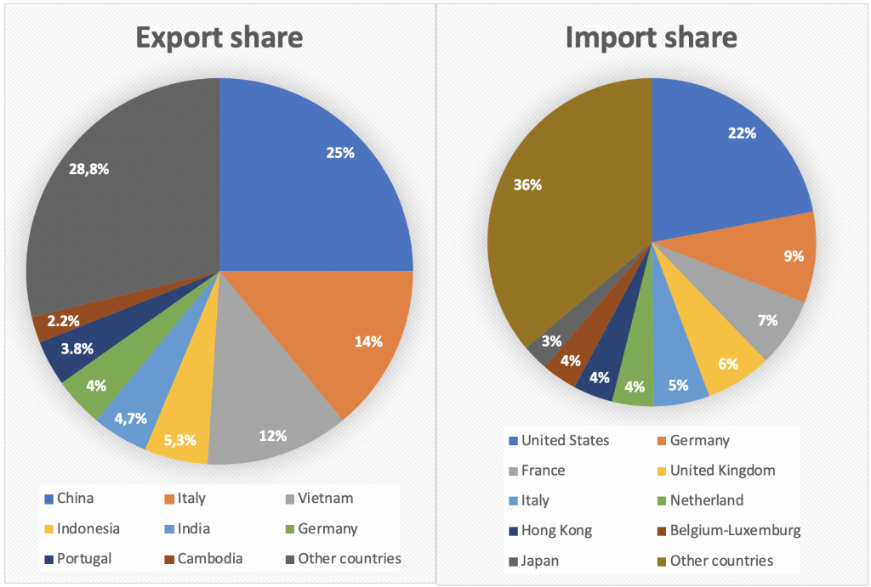
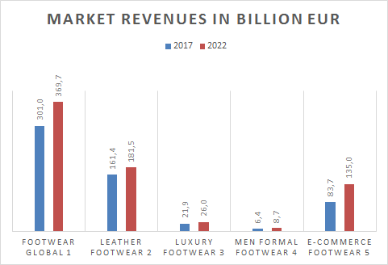
Market
CAGR
4,2 %
3,0 %
10,0%
3,5 %
6,2 %
Sources: 1 statista (2018), consumer market outlook – shoes; 2 statista (2018), 3 Footwear Report 2018 – Leather Footwear; 3 de.statista.com/outlook/21030200/100/luxusschuhe/weltweit ; 4 Allied Market research (2017): CO_172068; Men Formal Shoe Market by Shoe Type - Global Opportunity Analysis and Industry Forecast, 2014 – 2022; 5 statista (2018), e-Commerce Report 2018; 6 APICCAPS (2014): FOOTWEAR CONSUMER 2030; 7 Global Industry Analysts (2018): Report MCP-2782; FOOTWEAR – A GLOBAL STRATEGIC BUSINESS REPORT 8 The observatory of economic complexity (OEC) https://atlas.media.mit.edu/en/profile/hs92/6403/

Slide 8

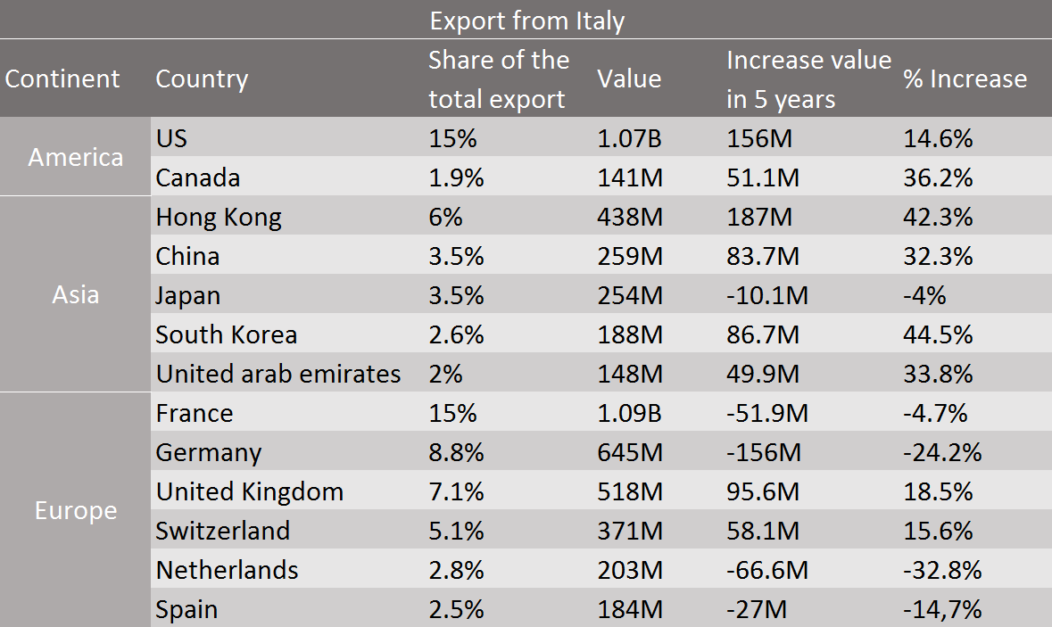
Trends
Consumption and spending power shift
Cultural globalization
Online presence, online as a sales channel
Sustainability
Personalized footwear
A return to timeless classics
Sources: 1 The observatory of economic complexity (OEC) https://atlas.media.mit.edu/en/profile/hs92/6403/; 2 statista (2018), 3 Footwear Report 2018 – Leather Footwear; 3 de.statista.com/outlook/21030200/100/luxusschuhe/weltweit ; 4 Allied Market research (2017): CO_172068; Men Formal Shoe Market by Shoe Type - Global Opportunity Analysis and Industry Forecast, 2014 – 2022; 5 statista (2018), e-Commerce Report 2018; 6 APICCAPS (2014): FOOTWEAR CONSUMER 2030; 7 Global Industry Analysts (2018): Report MCP-2782; FOOTWEAR – A GLOBAL STRATEGIC BUSINESS REPORT

Slide 9
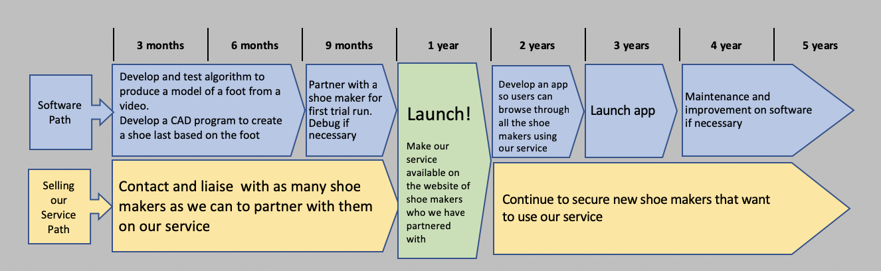
Operational Roadmap

Slide 10
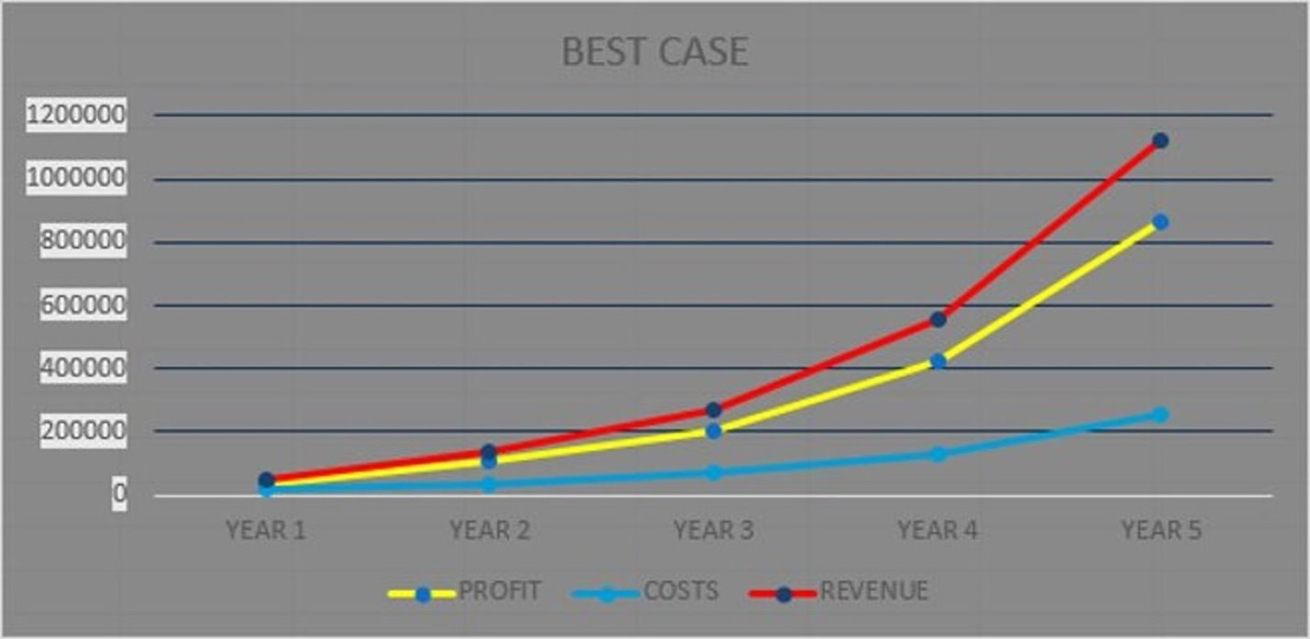
FINANCIAL RETURNS

Slide 11
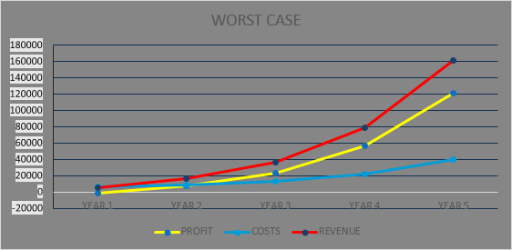
SENSITIVITY ANALYSIS

